Slide 1
Input /Output and Exception handling in Java

Slide 2
Agenda
Java I/O
Types of streams
File I/O using
Bytestream class
Characterstream class
Read(), readline()
Exception Handling
Types of exceptions.
Exception Handling using various Exception classes
User-defined Exceptions

Slide 3
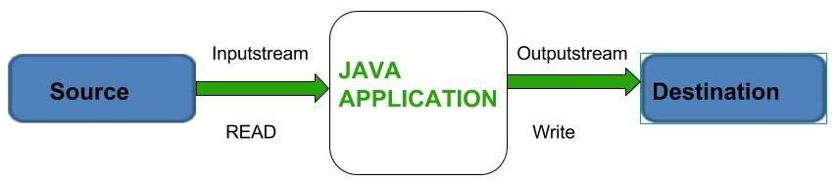
Java I/O
Java I/O (Input and Output) is used to process the input and produce the output.
Java uses the concept of a stream to make I/O operation faster.
The java.io package contains all the classes required for input and output operations.

Slide 4
Java I/O
Stream
A stream is a sequence of data. In Java, a stream is composed of bytes.
In Java, 3 streams are created for us automatically. All these streams are attached with the console.
System.in: This is the standard input stream that is used to read characters from the keyboard or any other standard input device.
System.out: This is the standard output stream that is used to produce the result of a program on an output device like the computer screen.
System.err: This is the standard error stream that is used to output all the error data that program might throw, on a computer screen or any standard output device.

Slide 5
Java I/O
E.g. To print the output message
System.out.println("simple message");
To print the error message
System.err.println("error message");
To get input from console.. int i=System.in.read();//returns ASCII code of 1st character
System.out.println((char)i); //will print the character

Slide 6
Types of Streams
Depending on the type of operations, streams can be divided into two primary classes:
Input Stream: These streams are used to read data that must be taken as an input from a source array or file or any peripheral device.
eg., FileInputStream, BufferedInputStream, ByteArrayInputStream etc.
Output Stream: These streams are used to write data as outputs into an array or file or any output peripheral device.
eg., FileOutputStream, BufferedOutputStream, ByteArrayOutputStream etc.

Slide 7
Cont..

Slide 8
Types of Streams
Depending on the types of file, Streams can be divided into two primary classes which can be further divided into other classes
ByteStream: This is used to process data byte by byte (8 bits). The FileInputStream and the FileOutputStream are the most popular ones. The FileInputStream is used to read from the source and FileOutputStream is used to write to the destination.
CharacterStream: In Java, characters are stored using Unicode conventions. Character stream automatically allows us to read/write data character by character. FileReader and FileWriter are character streams used to read from the source and write to the destination respectively.

Slide 9
Java Program illustrating the Byte Stream to copy contents of one file to another file.
import java.io.*;
public class BStream {
public static void main(
String[] args) throws IOException
{
FileInputStream sourceStream = null;
FileOutputStream targetStream = null;
try {
sourceStream = new FileInputStream("D:sourcefile.txt");
targetStream = new FileOutputStream("D:targetfile.txt");
// Reading source file and writing
// content to target file byte by byte
int temp;
while (( temp = sourceStream.read())!= -1)
targetStream.write((byte)temp);
}
finally {
if (sourceStream != null)
sourceStream.close();
if (targetStream != null)
targetStream.close();
}
System.out.println(“Data written”);
}
}
Output on console window
Data written

Slide 10
Java Program illustrating that can read a file in a human-readable format using FileReader
import java.io.*;
public class GfG {
public static void main(
String[] args) throws IOException
{
FileReader sourceStream = null;
try {
sourceStream
= new FileReader("D:sourcefile.txt");
// Reading sourcefile and
// writing content to target file
// character by character.
int temp;
while ((temp = sourceStream.read())
!= -1)
System.out.println((char)temp);
}
finally {
// Closing stream as no longer in use
if (sourceStream != null)
sourceStream.close();
}
System.out.println(“Data written”);
}
}
G
o
o
d
m
o
r
n
i
n
g
Output on console window

Slide 11
List of various ByteStream Classes
Stream class | Description
BufferedInputStream | It is used for Buffered Input Stream.
DataInputStream | It contains method for reading java standard datatypes.
FileInputStream | This is used to reads from a file
InputStream | This is an abstract class that describes stream input.
PrintStream | This contains the most used print() and println() method
BufferedOutputStream | This is used for Buffered Output Stream.
DataOutputStream | This contains method for writing java standard data types.
FileOutputStream | This is used to write to a file.
OutputStream | This is an abstract class that describe stream output.

Slide 12
List of various CharacterStream Classes
Stream class | Description
BufferedReader | It is used to handle buffered input stream.
FileReader | This is an input stream that reads from file.
InputStreamReader | This input stream is used to translate byte to character.
OutputStreamReader | This output stream is used to translate character to byte.
Reader | This is an abstract class that define character stream input.
PrintWriter | This contains the most used print() and println() method
Writer | This is an abstract class that define character stream output.
BufferedWriter | This is used to handle buffered output stream.
FileWriter | This is used to output stream that writes to file.

Slide 13
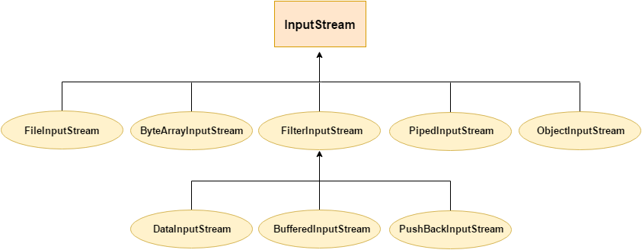
InputStream Hierarchy
InputStream class is an abstract class. It is the superclass of all classes representing an input stream of bytes.

Slide 14
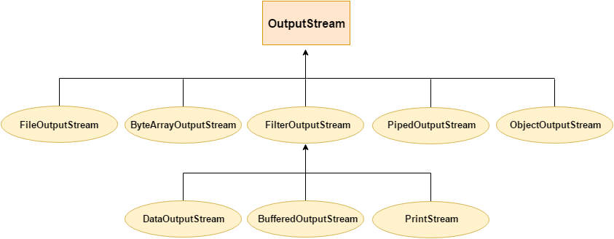
OutputStream Hierarchy
OutputStream class is an abstract class. It is the superclass of all classes representing an output stream of bytes.

Slide 15
BufferedReader and BufferedWriter
Syntax: Reading:
FileReader fr=new FileReader("D:\\sourcefile.txt");
BufferedReader br=new BufferedReader(fr);
Pass FileReader object to BufferedReader Class as a parameter.
Writing:
FileWriter writer = new FileWriter("D:\\testout.txt");
BufferedWriter buffer = new BufferedWriter(writer);
Pass FileWriter object to BufferedWriter Class as a parameter.

Slide 16
Write a program to read from a file using BufferedReader class and write to Target File using BufferedWriter Class. //Note:read() method reads character by character
public class file2 {
public static void main(String args[]) throws Exception {
FileReader fr = new FileReader("D:\\sourcefile.txt"); //make sure u have this file created with contents.
FileWriter fw = new FileWriter("D:\\vtarget.txt");
BufferedReader br = new BufferedReader(fr);
BufferedWriter bw = new BufferedWriter(fw);
int i;
while ((i = br.read()) != -1)
{
bw.write((char) i); // for writing to target file
System.out.print((char)i); // for writing to the console
}
System.out.println("data written");
bw.close();
br.close();
fw.close();
fr.close();
}}

Slide 17
Same program but with readLine() method //note: readLine() method reads line of text
public class file2 {
public static void main(String args[]) throws Exception {
FileReader fr = new FileReader("D:\\sourcefile.txt");
FileWriter fw = new FileWriter("D:\\Rtarget.txt");
BufferedReader br = new BufferedReader(fr);
BufferedWriter bw = new BufferedWriter(fw);
String str;
while ((str = br.readLine()) != null)
{
bw.write(str); // for writing to another file
System.out.println(str); //for writing to the console
}
bw.close();
br.close();
fw.close();
fr.close();
System.out.println("data written");
} }

Slide 18
Exception Handling in JAVA

Slide 19
Agenda
Understand the different types of exceptions.
Exception Handling using various Exception classes

Slide 20
Exception Handling in Java
An exception is an unexpected event that occurs during program execution. It affects the flow of the program instructions which can cause the program to terminate abnormally.
The Exception Handling in Java is one of the powerful mechanism to handle the runtime errors so that the normal flow of the application can be maintained.
All the exceptions occur only at runtime.
A syntax error occurs at compile time.
An exception can be identified only at runtime, not at compile time.

Slide 21
Examples of Exceptions
Opening a non-existing file in your program.
Reading a file from a disk but the file does not exist there.
Writing data to a disk but the disk is full or unformatted.
When the program asks for user input and the user enters invalid data.
When a user attempts to divide an integer value by zero, an exception occurs.
When accessing an array index where value does not exist, etc.

Slide 22
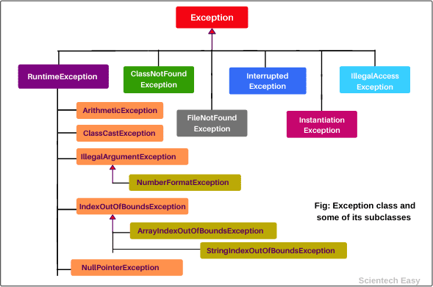
Exception Class Hierarchy

Slide 23
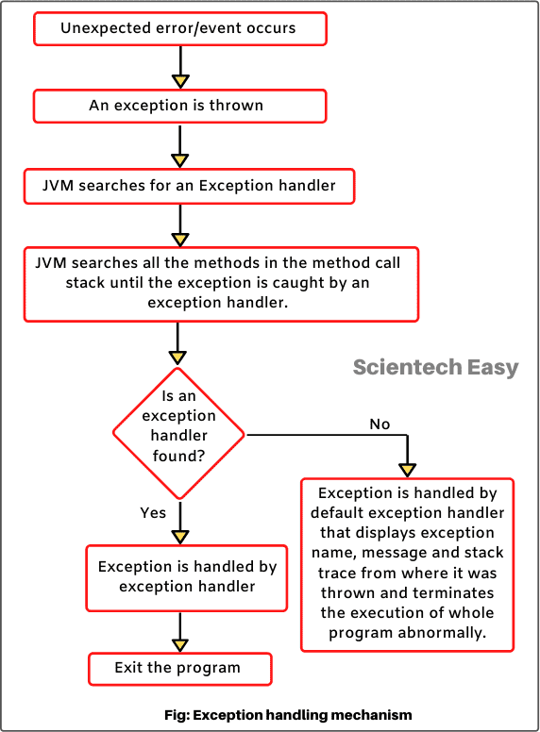
Exception handling mechanism

Slide 24
Error Vs Exception
Type of comparison | Exception | Error
Package | It belongs to java.lang.Exception package. | It belongs to java.lang.Error package.
Occurrence | It occurs at run time. | It occurs at compile time or run time.
Causes | It is mainly caused by the application itself. | It is mostly caused by the environment in which the application is running.
Recoverable/ Irrecoverable | It is recoverable | It is irrecoverable
Type | Classified as an checked and unchecked type | Classified as unchecked type.
Example | Checked Exception-NullPointerException , SqlException Uncheckedexceptions: ArrayIndexOutOfBoundException, NullPointerException, ArithmaticException | OutOfMemoryError , StackOverflowError

Slide 25
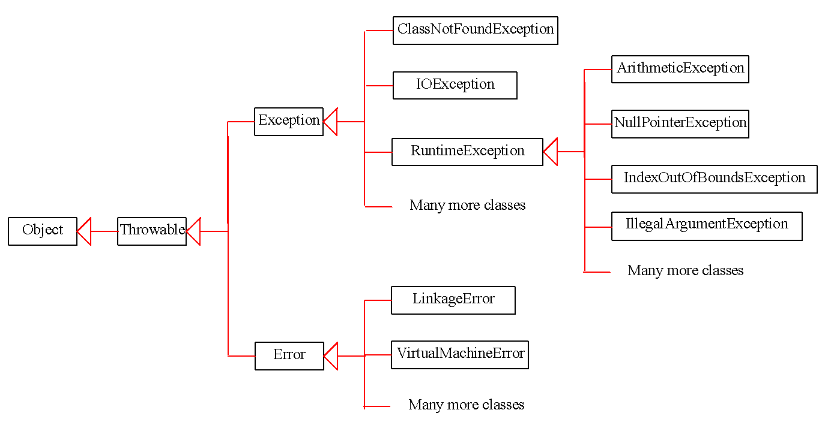
Exception Types

Slide 26
System Errors
System errors are thrown by JVM and represented in the Error class. The Error class describes internal system errors. Such errors rarely occur. If one does, there is little you can do beyond notifying the user and trying to terminate the program gracefully.

Slide 27
Exceptions
Exception describes errors caused by your program. These errors can be caught and handled by your program.

Slide 28
Runtime Exceptions
RuntimeException is caused by programming errors, such as bad casting, accessing an out-of-bounds array, and numeric errors.

Slide 29
Checked Exceptions vs. Unchecked Exceptions
RuntimeException, Error and their subclasses are known as unchecked exceptions.
All other exceptions are known as checked exceptions, meaning that the compiler forces the programmer to check and deal with the exceptions.

Slide 30
Unchecked Exceptions
In most cases, unchecked exceptions reflect programming logic errors that are not recoverable. For example, a NullPointerException is thrown if you access an object through a reference variable before an object is assigned to it;
An IndexOutOfBoundsException is thrown if you access an element in an array outside the bounds of the array.
Unchecked exceptions can occur anywhere in the program. To avoid cumbersome overuse of try-catch blocks, Java does not mandate you to write code to catch unchecked exceptions.

Slide 31
Unchecked Exceptions
Unchecked exception.

Slide 32
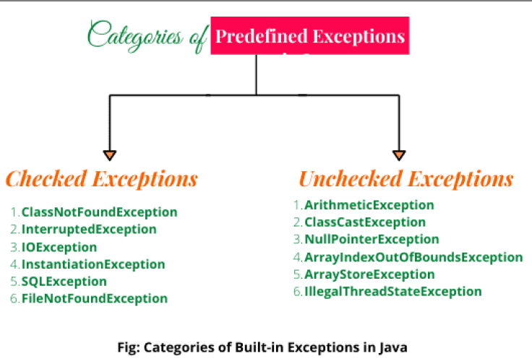

Slide 33
checked Exceptions
ClassNotFoundException: The ClassNotFoundException is a kind of checked exception that is thrown when we attempt to use a class that does not exist. Checked exceptions are those exceptions that are checked by the Java compiler itself.
FileNotFoundException: The FileNotFoundException is a checked exception that is thrown when we attempt to access a non-existing file.
InterruptedException: InterruptedException is a checked exception that is thrown when a thread is in sleeping or waiting state and another thread attempt to interrupt it.
InstantiationException: This exception is also a checked exception that is thrown when we try to create an object of abstract class or interface. That is, InstantiationException exception occurs when an abstract class or interface is instantiated.
IllegalAccessException: The IllegalAccessException is a checked exception and it is thrown when a method is called in another method or class but the calling method or class does not have permission to access that method.
CloneNotSupportedException: This checked exception is thrown when we try to clone an object without implementing the cloneable interface.
NoSuchFieldException: This is a checked exception that is thrown when an unknown variable is used in a program.
NoSuchMethodException: This checked exception is thrown when the undefined method is used in a program.

Slide 34
Unchecked Exceptions
ArithmeticException: This exception is thrown when arithmetic problems, such as a number is divided by zero, is occurred. That is, it is caused by maths error.
ClassCastException: The ClassCastException is a runtime exception that is thrown by JVM when we attempt to invalid typecasting in the program. That is, it is thrown when we cast an object to a subclass of which an object is not an instance.
IllegalArgumentException: This runtime exception is thrown by programmatically when an illegal or appropriate argument is passed to call a method. This exception class has further two subclasses:
NumericFormatException:NumberFormatException is thrown by programmatically when we try to convert a string into the numeric type and the process of illegal conversion fails. That is, it occurs due to the illegal conversion of a string to a numeric format.
IllegalThreadStateException: IllegalThreadStateException exception is a runtime exception that is thrown by programmatically when we attempt to perform any operation on a thread but it is incompatible with the current thread state.
IndexOutOfBoundsException: This exception class is thrown by JVM when an array or string is going out of the specified index. It has two further subclasses:
ArrayIndexOutOfBoundsException: ArrayIndexOutOfBoundsException exception is thrown when an array element is accessed out of the index.
StringIndexOutOfBoundsException: StringIndexOutOfBoundsException exception is thrown when a String or StringBuffer element is accessed out of the index.

Slide 35
Unchecked Exceptions
NullPointerException: NullPointerException is a runtime exception that is thrown by JVM when we attempt to use null instead of an object. That is, it is thrown when the reference is null.
ArrayStoreException: This exception occurs when we attempt to store any value in an array which is not of array type. For example, suppose, an array is of integer type but we are trying to store a value of an element of another type.
7. IllegalStateException: The IllegalStateException exception is thrown by programmatically when the runtime environment is not in an appropriate state for calling any method.
IllegalMonitorStateException: This exception is thrown when a thread does not have the right to monitor an object and tries to access wait(), notify(), and notifyAll() methods of the object.
NegativeArraySizeException: The NegativeArraySizeException exception is thrown when an array is created with a negative size.

Slide 36
Exception Handling using Try-Catch
The try block contains set of statements where an exception can occur.
A try block is always followed by a catch block, which handles the exception that occurs in associated try block.
A try block must be followed by catch blocks or finally block or both.
Syntax of try block try
{
//statements that may cause an exception
}
While writing a program, if you think that certain statements in a program can throw a exception, enclosed them in try block and handle that exception

Slide 37
Catch Block
A catch block is where you handle the exceptions, this block must follow the try block.
A single try block can have several catch blocks associated with it.
You can catch different exceptions in different catch blocks.
When an exception occurs in try block, the corresponding catch block that handles that particular exception executes.
For example: If an arithmetic exception occurs in try block then the statements enclosed in catch block for arithmetic exception executes.

Slide 38
Try-Catch Example
public class re {
public static void main(String[] args) {
try
{
int num = 45/0; // throw exception
}
//handling the exception
catch(ArithmeticException e)
{
System.out.println("exception->"+e);
}
System.out.println("rest of the code");
}
}
Syntax of try catch in java
try
{
//statements that may cause an exception
}
catch (exception(type) e(object))
{
//error handling code
}

Slide 39
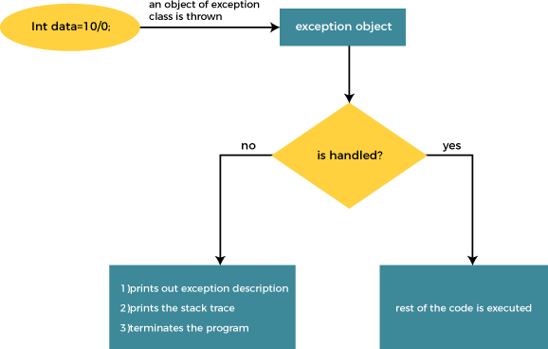
Internal Working

Slide 40
Multiple Catch Block
public class re {
public static void main(String[] args) {
Scanner sc=new Scanner(System.in);
System.out.println("Enter two integer numbers");
// Read two integer numbers.
int num1 = sc.nextInt();
int num2 = sc.nextInt();
try {
System.out.println(num1 + "/" + num2 + " = " + (num1/num2));
}catch(ArithmeticException e) //multiple catch statement
{
System.out.println(“Arithmetic excp. Divide by 0");
}catch(Exception e) //superClass
{
System.out.println(“ excep. Class divide by 0");
}finally { //finally block gets executed regardless of try... catch.
System.out.println("The 'try catch' is finished.");
}
}}
A single try block can have any number of catch blocks.
A generic catch block can handle all the exceptions. Whether it is ArrayIndexOutOfBoundsException or ArithmeticException or NullPointerException or any other type of exception, this handles all of them.
If no exception occurs in try block then the catch blocks are completely ignored.
Corresponding catch blocks execute for that specific type of exception:
catch(ArithmeticException e)
is a catch block that can handle ArithmeticException
catch(NullPointerException e)
is a catch block that can handle
NullPointerException

Slide 41
Nested Try-Catch
When a try catch block is present in another try block then it is called the nested try catch block.
Each time a try block does not have a catch handler for a particular exception, then the catch blocks of parent try block are inspected for that exception, if match is found then that catch block executes.
..
//main try block
try{
stmt1;
stmt2;
//try-catch block inside another block
try{
stmt3;
stmt4;
//try-catch block inside nested try block
try{
stmt5;
stmt6;
} catch (Exception e2)
{ //exception message }
}catch(Exception e1)
{//exception message}
}
// catch of main (parent) try block
catch(Exception e3)
{//exception message}
….

Slide 42
Finally block
A finally block must be associated with a try block, you cannot use finally without a try block. You should place those statements in this block that must be executed always.
Finally block is optional, as we have seen that a try-catch block is sufficient for exception handling, however if you place a finally block then it will always run after the execution of try block.
In normal case when there is no exception in try block then the finally block is executed after try block. However if an exception occurs then the catch block is executed before finally block.
An exception in the finally block, behaves exactly like any other exception.
The statements present in the finally block execute even if the try block contains control transfer statements like return, break or continue.

Slide 43
Try-catch-finally block
Either a try statement should be associated with a catch block or with finally.
Since catch performs exception handling and finally performs the cleanup, the best approach is to use both of them.
try
{
//statements that may cause an exception
}
catch (…)
{
//error handling code
}
finally
{
//statements to be executed
}

Slide 44
Flow of control in try-catch-finally block
1. If exception occurs in try block’s body the control immediately transferred(skipping rest of the statements in try block) to the catch block. Once catch block finished execution then finally block and after that rest of the program.
If there is no exception occurred in the code which is present in try block then first, the try block gets executed completely and then control gets transferred to finally block (skipping catch blocks).
If a return statement is encountered either in try or catch block. In this case finally block runs. Control first jumps to finally and then it comes back to return statement.

Slide 45
Throw in Java
The throw keyword in Java is used to explicitly throw an exception from a method or any block of code.
We can throw either checked or unchecked exceptions. The throw keyword is mainly used to throw custom exceptions.
Syntax:
throw Instance
Example:
throw new ArithmeticException("/ by zero");

Slide 46
Throw in Java
The flow of execution of the program stops immediately after the throw statement is executed and the nearest enclosing try block is checked to see if it has a catch statement that matches the type of exception.
If it finds a match, control is transferred to that statement otherwise next enclosing try block is checked and so on.
If no matching catch is found then the default exception handler will halt the program.

Slide 47
Throwing unchecked Exception
public class test
{
public static void check(int age){
if (age<18)
{ throw new ArithmeticException("not eligible to vote");}
else
{ System.out.println("Person is eligible to vote");
}
}
public static void main(String args[])
{
check(12);
System.out.println("rest of the code");
}
}
Ex. 2

Slide 48
Throws in Java
The throws keyword in Java is used to declare exceptions that can occur during the execution of a program.
For any method that can throw exceptions, it is mandatory to use the throws keyword to list the exceptions that can be thrown.
The throws keyword provides information about the exceptions to the programmer as well as to the caller of the method that throws the exceptions.

Slide 49
Throws in Java
public class re{
public static void checkage(int age) throws ArithmeticException{
if (age<18)
{
throw new ArithmeticException(" not eligible to vote");
}
else
{ System.out.println("Person is eligible to vote");}
}
public static void main(String agrs[])
{
checkage(21);
}
}
Ex. 3

Slide 50
Throwing Checked Exception
import java.io.*;
public class TestThrow2 {
//function to check if person is eligible to vote or not
public static void method() throws FileNotFoundException { FileReader file = new FileReader("C:\\Users\\Desktop\\abc.txt");
BufferedReader fileInput = new BufferedReader(file);
throw new FileNotFoundException();
Ex. 1
}
//main method
public static void main(String args[]){ try
{
method();
}
catch (FileNotFoundException e)
{
e.printStackTrace();
}
System.out.println("rest of the code...");
}
}

Slide 51
Throw and Throws in Java
Throw | Throws
Used within a method (or constructor) | Used with method (or constructor) signature
Used to throw an exception explicitly | Used to declare exceptions
Can only throw a single exception | Can declare multiple exceptions
Followed by a throwable instance | Followed by an exception class name

Slide 52
User defined exception in Java
In order to create custom exception, we need to extend Exception class that belongs to java.lang package.
//class that uses custom exception InvalidAgeException
public class re {
// method to check the age
static void validate (int age) throws Exception{
if(age < 18){
// throw an object of user defined exception
throw new Exception("age is not valid to vote");
}
else {
System.out.println("welcome to vote");
} }
// main method
public static void main(String args[]) {
try {
// calling the method
validate(13); }
catch (Exception ex) {
System.out.println("Caught the exception");
// printing the message from InvalidAgeException object
System.out.println("Exception occured: " + ex); }
System.out.println("rest of the code...");
} }

Slide 53
User defined exception in Java-
In order to create custom exception, we need to extend Exception class that belongs to java.lang package.
class InvalidAgeException extends Exception{
public InvalidAgeException (String str)
{
super(str); // calling the constructor of parent Exception
}
}
//class that uses custom exception InvalidAgeException
public class re {
// method to check the age
static void validate (int age) throws Exception{
if(age < 18){
// throw an object of user defined exception
throw new InvalidAgeException("age is not valid to vote");
}else {
System.out.println("welcome to vote");
} }
// main method
public static void main(String args[]) {
try {
validate(13); // calling the method
} catch (Exception ex) {
System.out.println("Caught the exception");
// printing the message from InvalidAgeException object
System.out.println("Exception occured: " + ex); }
System.out.println("rest of the code...");
} }

Slide 54
class EmployeeException extends Exception{
public EmployeeException(String s){
super(s);
}
}
class SampleEmp{
void empIDCheck(int EmpID) throws EmployeeException{
if(EmpID<=0 || EmpID>999){
throw new EmployeeException("Invalid Employee ID");
}
}
public static void main(String args[]){
SampleEmp emp = new SampleEmp();
try{
emp.empIDCheck(0);
}
catch (EmployeeException e){
System.out.println("Exception caught");
System.out.println(e.getMessage());
}}}

Slide 55
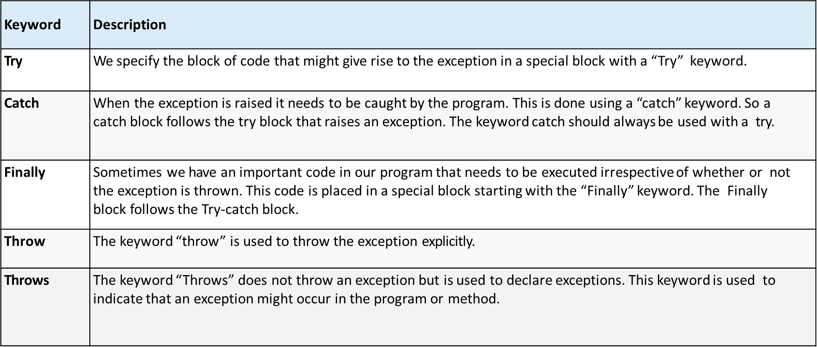
Key learnings

Slide 56
References
The Complete Reference Book – JAVA , Herbert Schilt

Slide 57
Thank You!!

